Slide 1
Studying Adaptation:
Evolutionary Analysis of
Form and Function

Slide 2
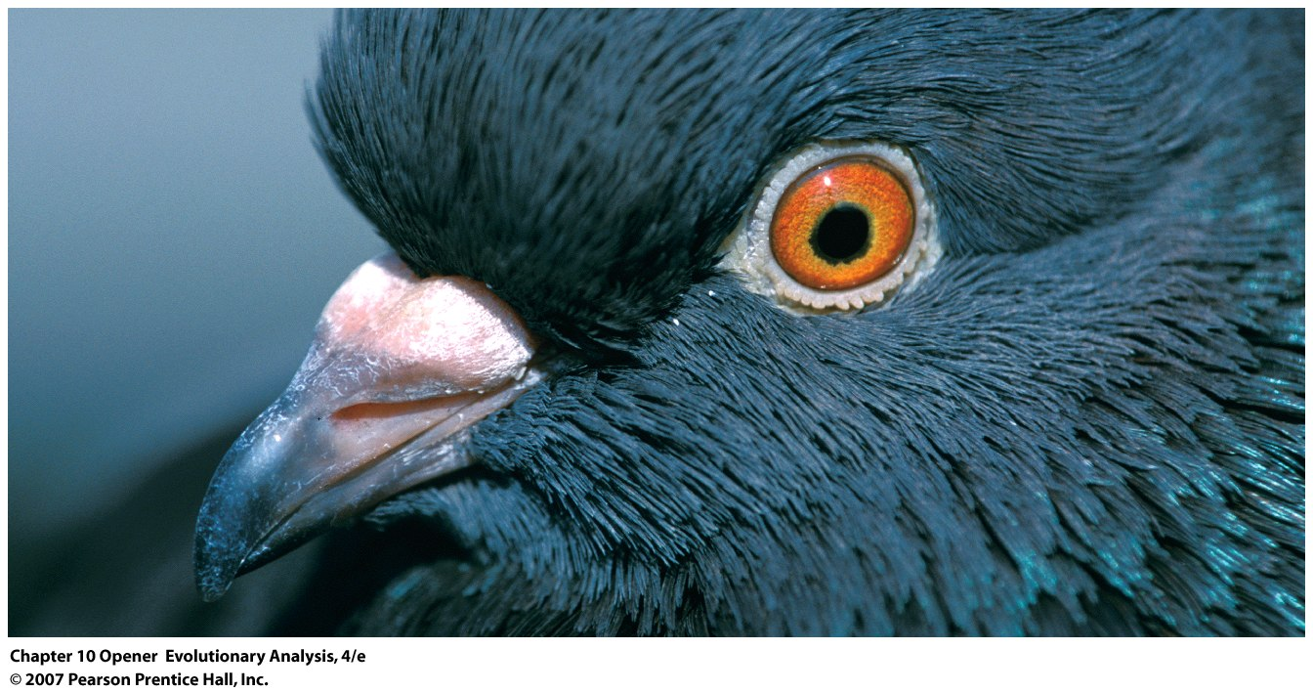
Experimental manipulation of traits
One can isolate and test the effect of single (or multiple factors) on fitness using well-designed experiments.
Notes:
Chapter 10 Opener
Pigeons shorn of the hooks on the tips of their beaks suffer worsening infestations of lice. Pigeons allowed to regrow their hooks (red) fare better than continuously trimmed pigeons (blue). Redrawn from Clayton et al. (2005).

Slide 3
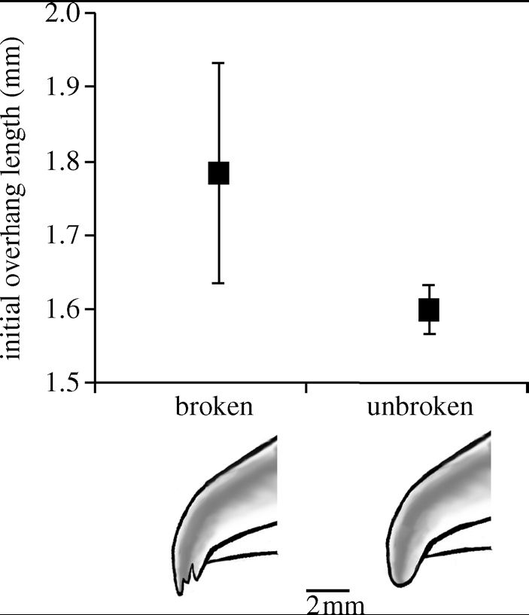
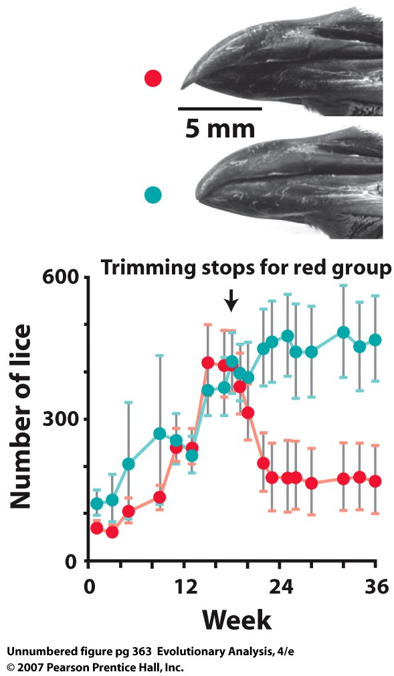
Adaptive significance of
hooked beak
Relationship of overhang length to breakage.
The overhangs of 13 birds that suffered breaks were initially longer than those of 111 birds without breaks;
http://www.youtube.com/watch?v=8tjJODKZ_bc
Notes:
Chapter 10 Opener
Pigeons shorn of the hooks on the tips of their beaks suffer worsening infestations of lice. Pigeons allowed to regrow their hooks (red) fare better than continuously trimmed pigeons (blue). Redrawn from Clayton et al. (2005).

Slide 4
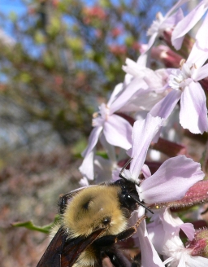
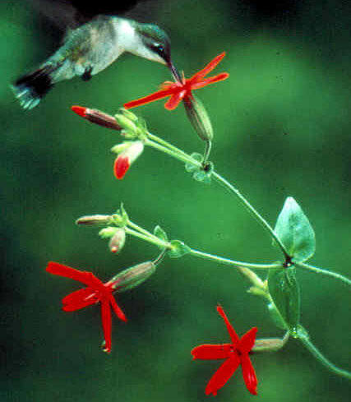
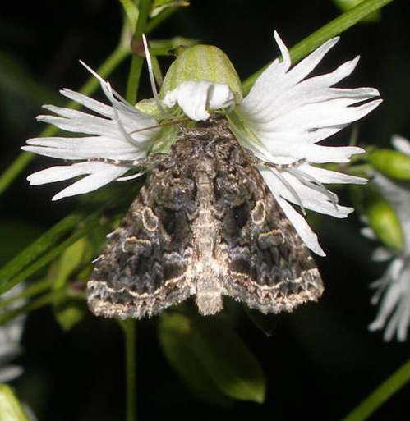
Quantifying the role of pollinator-mediated selection on
Silene virginica, S. stellata, and S. caroliniana
S. caroliniana S. virginica S. stellata
18 mm 25 mm 10 mm
Corolla Tube (flower) Length
Notes:
4

Slide 5
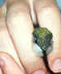
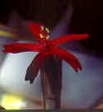
Artificial manipulations:
Effect of Corolla Tube Length on
Male Reproductive Success
X + 2 STD
X
X + 2 STD
5
Dudash et al 2011
Beak Insertion Difference
Notes:
5

Slide 6
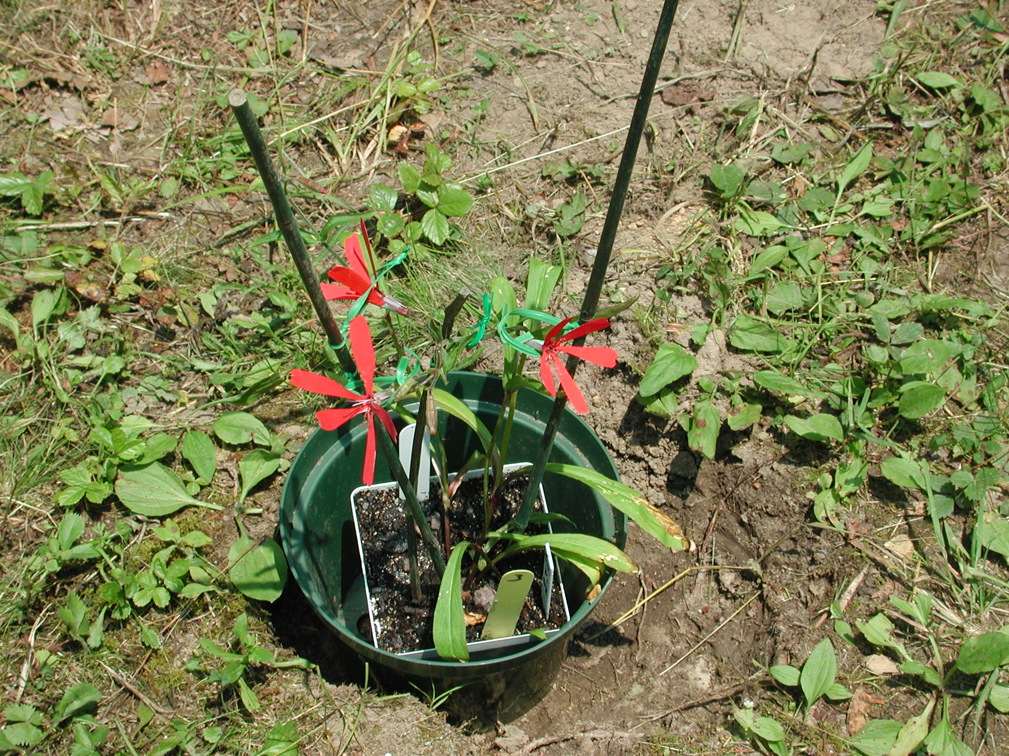
Selection on corolla tube length via male reproductive success
S,M,L
S,M,L
S,M,L
Hummingbirds are agents of selection on S. virginica:
-Corolla tube length (++ MRS), p < 0.0001
Dudash et al. 2011 AJB
Notes:
6

Slide 7
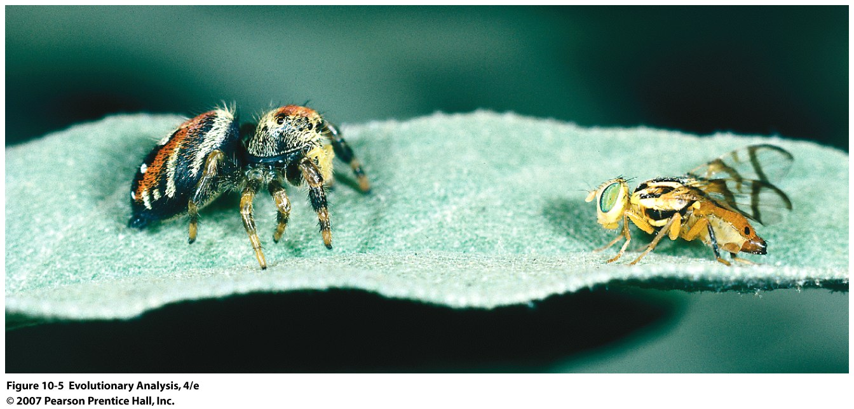
Fly that mimics its own predator, the jumping spider
Notes:
Figure 10.5 A sheep in wolf's clothing?
This photograph shows the tephritid fly Zonosemata vittigera (right) facing one of its predators, the jumping spider Phidippus apacheanus (left).
American SW

Slide 8
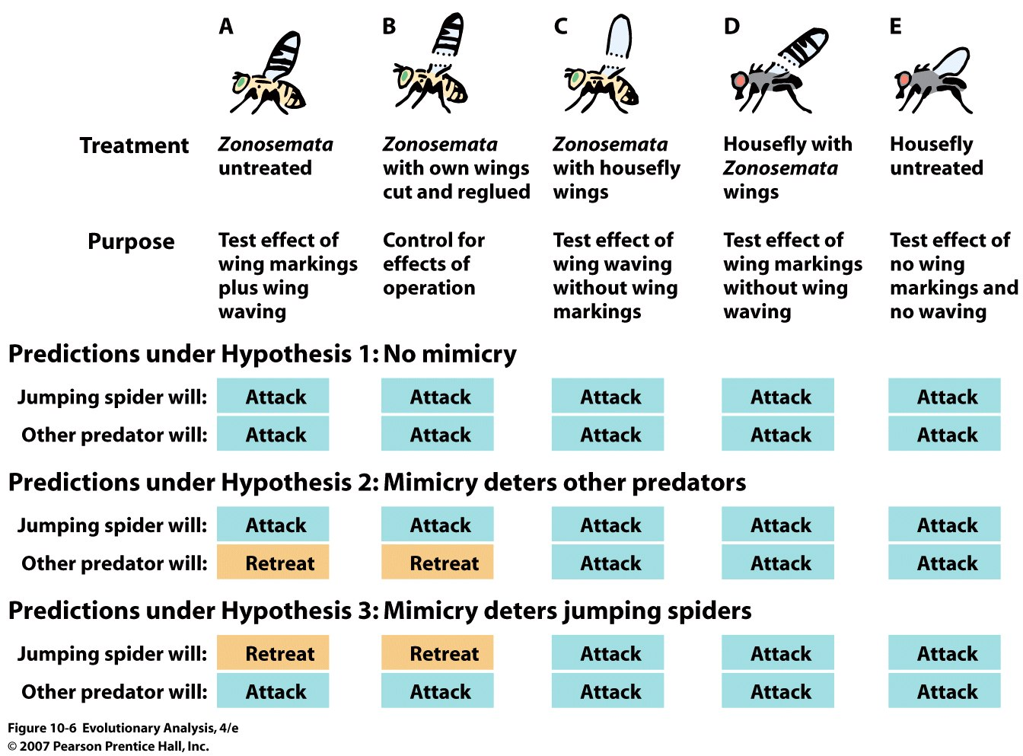
Notes:
Figure 10.6 Surgical treatments used in experiments testing the function of wing-waving display
This table shows the predicted outcomes when different predators encounter flies with different treatments. Note that each hypothesis makes a unique suite of predictions. (The predictions listed for hypotheses 2 and 3 assume that both Zonosemata's wing markings and wing waving are necessary for effective mimicry.).
Note that mimicry deters other predators or jumping spiders are H 2 and 3

Slide 9
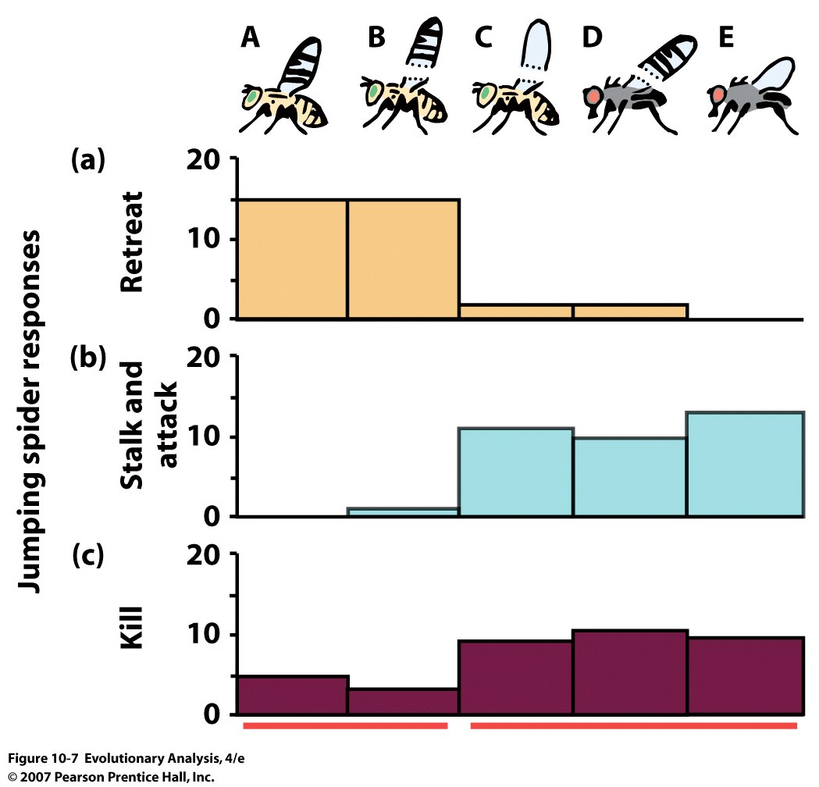
No effect of treatments on the behavior of OTHER PREDATORS
Notes:
Figure 10.7 Tephritid flies mimic jumping spiders to avoid predation
These graphs show how jumping spiders reacted to the fly types listed in Figure 10.6. The height of each bar represents the number of jumping spiders, out of 20, that showed each type of maximum response to each type of fly. Thus, for group A flies, 15 of the spiders retreated from their test flies [graph (a)], and five killed their test flies [graph (c)]. For group B flies, 15 of the spiders retreated from their flies, 2 stalked and attacked but did not kill their flies, and 3 killed their flies. From Greene et al. (1987). Most of the flies that waved marked wings (groups A and B) survived their encounters with spiders unscathed, whereas most of the flies that lacked markings or waving or both were attacked, and many were killed. The red bars at bottom identify treatment groups where the spider responses were statistically indistinguishable from one another. Groups A and B were indistinguishable from each other, but different from groups C, D, and E. Because each spider was presented with one fly of each type, the sample size in each treatment group was 20.

Slide 10
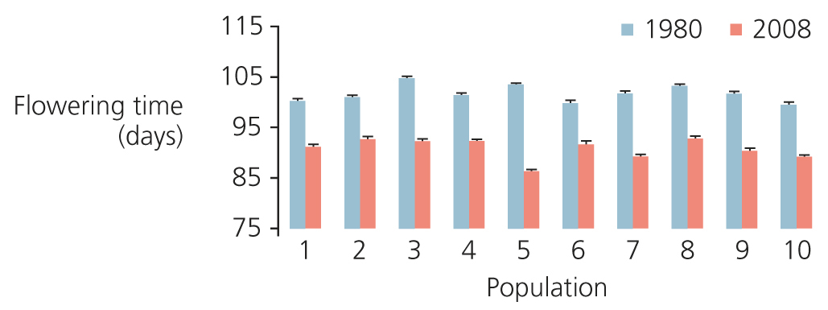
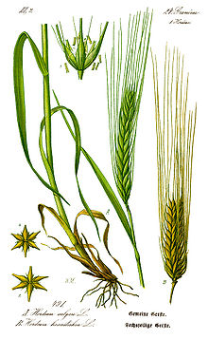
II. Evolution in the short-term
Evolution of Wild Barley Populations in the Middle East
in Response to Global Climate Change:
Nevo et al. 2010
Wikipedia

Slide 11
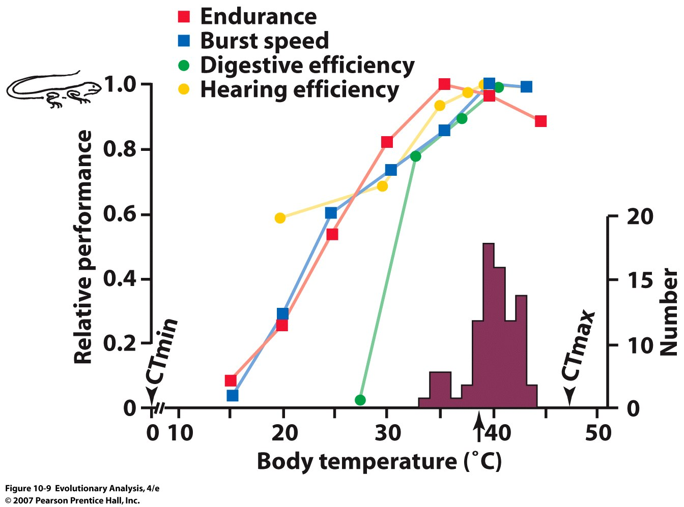
III. Tests of association
(within population)
Desert iguana
Dipsosaurus dorsalis
Arrow = temp in lab
Notes:
Figure 10.9 Physiological abilities of the desert iguana (Dipsosaurus dorsalis) as a function of body temperature
The colored squares and circles show locomotor endurance, burst (sprint) speed, digestive efficiency, and hearing efficiency of iguanas as a function of body temperature. The shaded region is a histogram showing the distribution of body temperatures for active iguanas captured in nature. The black arrow indicates the body temperature chosen by iguanas in the lab. CTmax is the critical thermal maximum, that is, the temperature above which the lizard cannot right itself. CTmin is the critical thermal minimum. Reprinted from Huey and Kingsolver (1989).

Slide 12
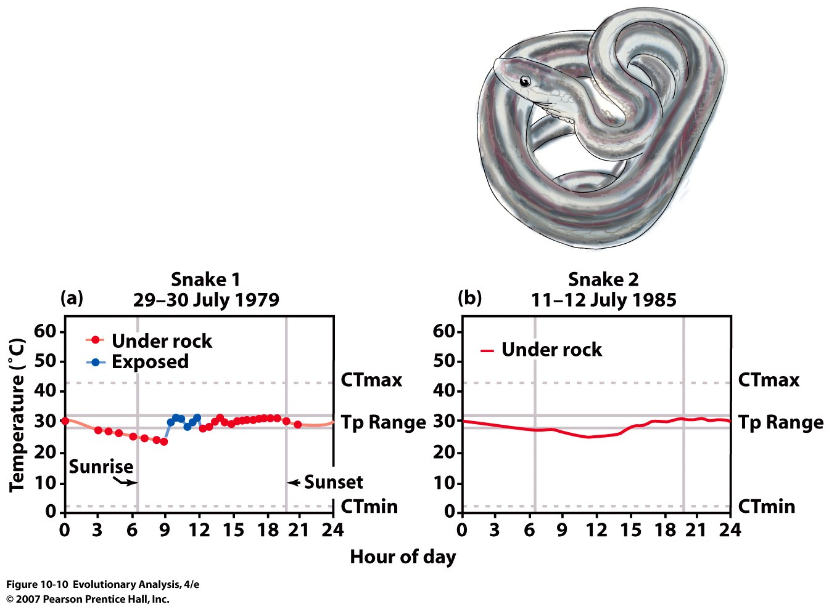
Garter Snake
Thamnophis elegans
Notes:
Figure 10.10 Body temperatures of garter snakes in nature
(a) Snake 1 spent part of the day under a rock (red dots and line), and part of the day in the sun (blue dots and line). (b) Snake 2 spent the entire day under a rock. Tp is the preferred temperature range, measured in the lab. CTmax and CTmin are defined in Figure 10.9. Both snakes kept their temperature near 30 degrees C for the entire day. From Huey et al. (1989b).

Slide 13
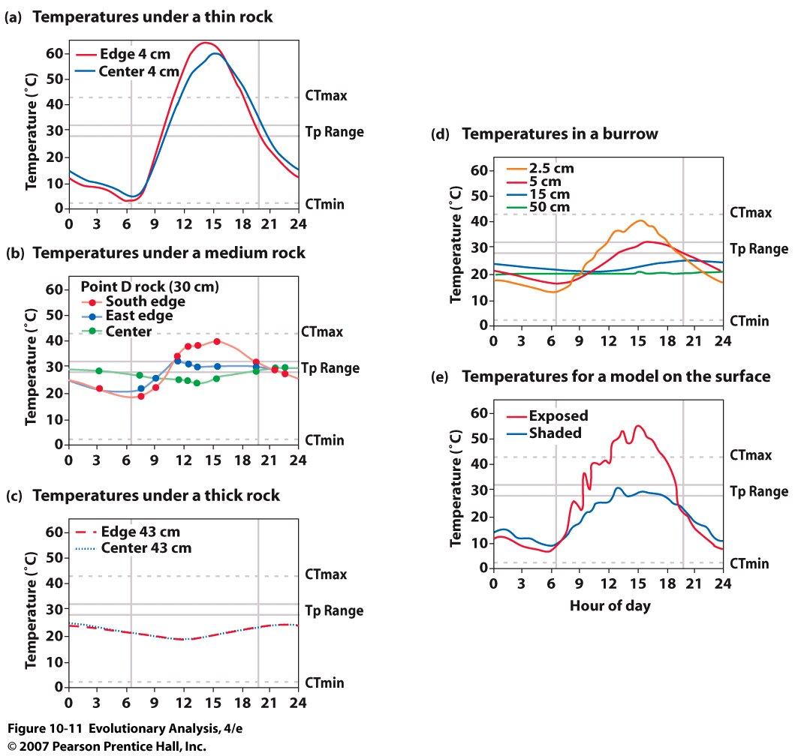
Notes:
Figure 10.11 Environmental temperatures available to garter snakes at Eagle Lake N. California
The graphs show the daily cycle of temperatures in various places a snake might go. Under a thin (4 cm) rock (a), it is cold at night and hot during the day. Under a thick (43 cm) rock (c), it is cool all the time. Under a medium (30 cm) rock (b), there is virtually always a spot within the range of temperatures preferred by snakes. In a burrow (d), it is cool at night and cool to warm in the daytime, with the exact temperature depending on depth within the burrow. On the surface (e), it is cold at night and just right to hot in the daytime, depending on whether a snake is in shade or direct sunlight. From Huey et al. (1989b).

Slide 14
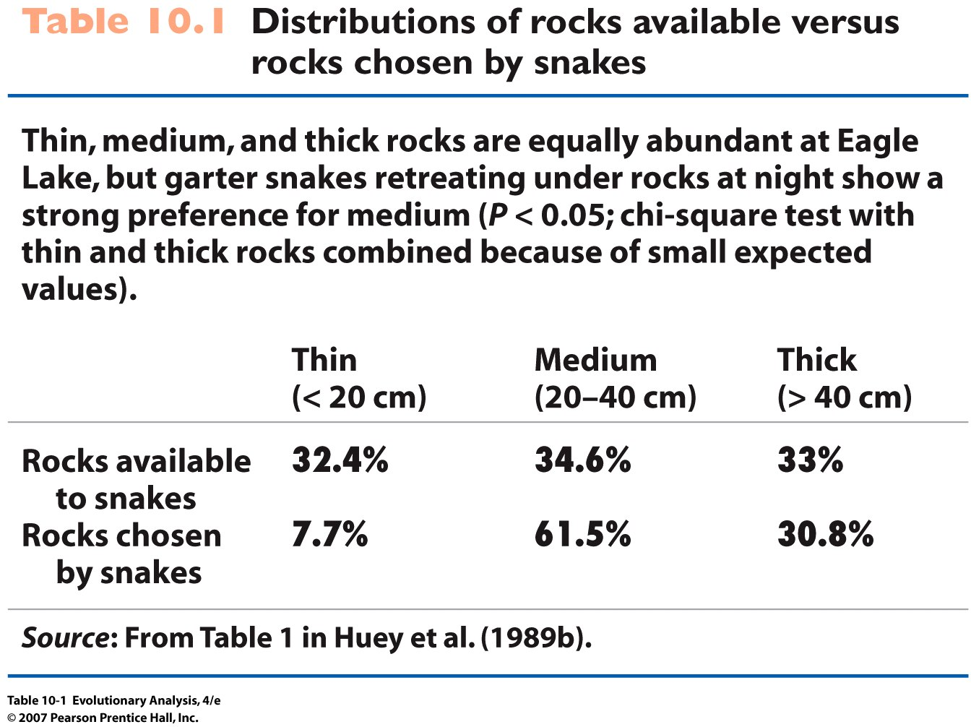
Notes:
Table 10.1 Distributions of rocks available versus rocks chosen by snakes

Slide 15
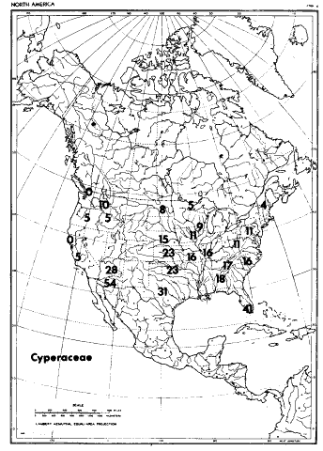
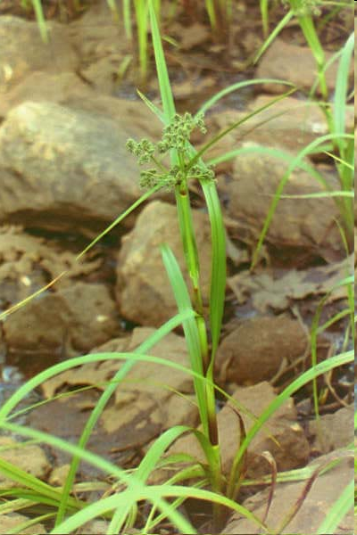
IV. Tests of association
Across species
Percent of C4 species in the Cyperaceae in 25 regions of the USA
and Mexico (Teeri et al. Oecolgia 1980

Slide 16
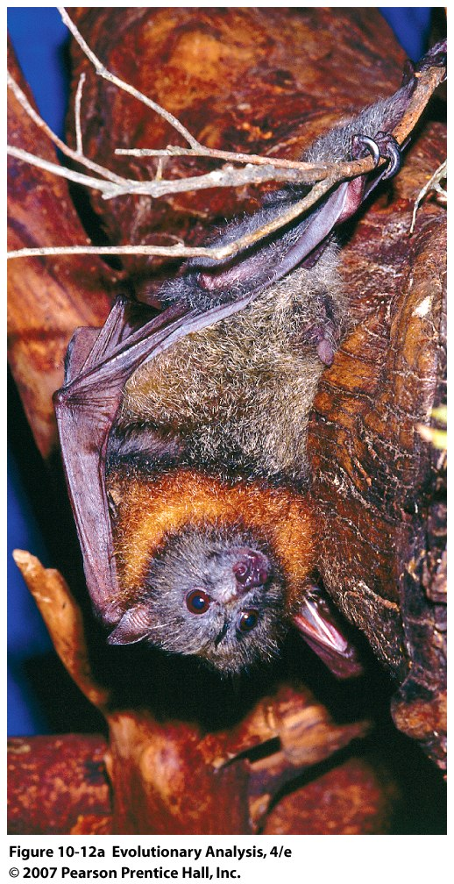
Phylogenetic
approaches
Grey-headed flying fox
Pteropus poliocephalus
Notes:
Figure 10.12a Variation in testis size among fruit bats and flying foxes
(a) A grey-headed flying fox (Pteropus poliocephalus).

Slide 17
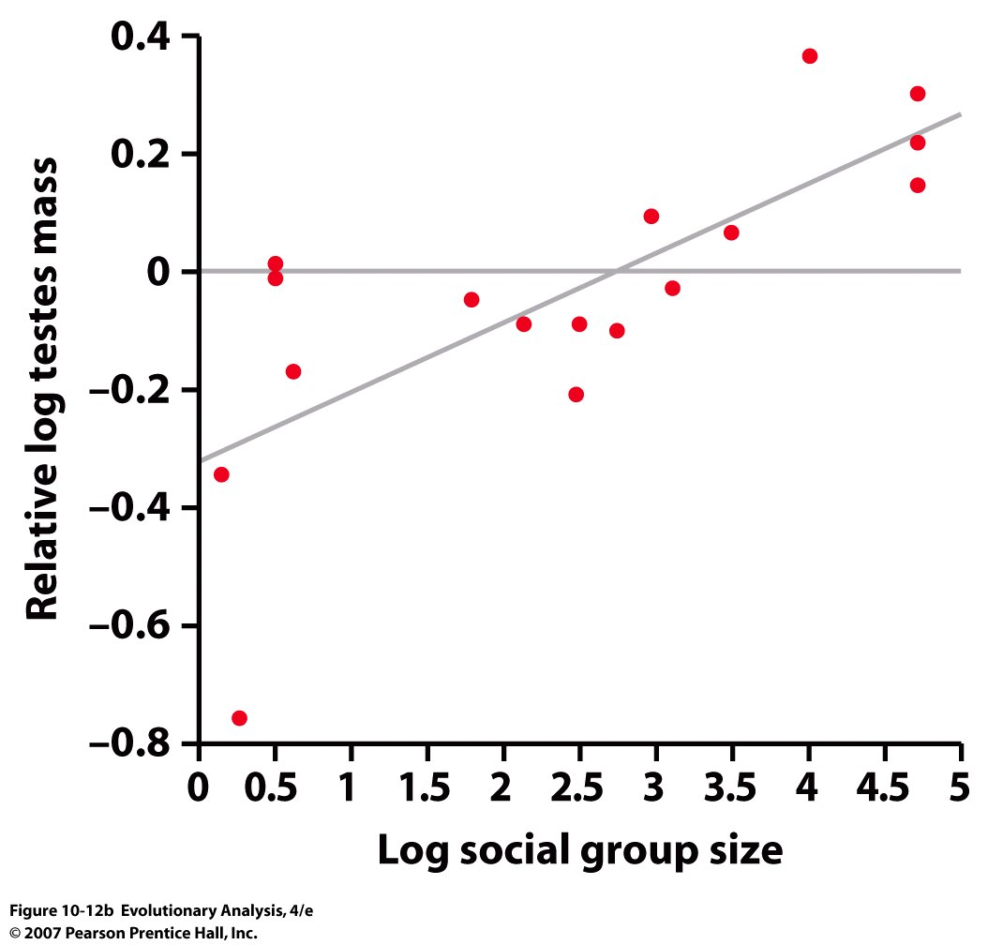
Variation in testis size among fruit bats and flying foxes
Notes:
Figure 10.12b Variation in testis size among fruit bats and flying foxes
(b) Relative testes size (that is, testes size adjusted for body size) as a function of roost group size for 17 species of fruit bats and flying foxes. From Hosken (1998).

Slide 18
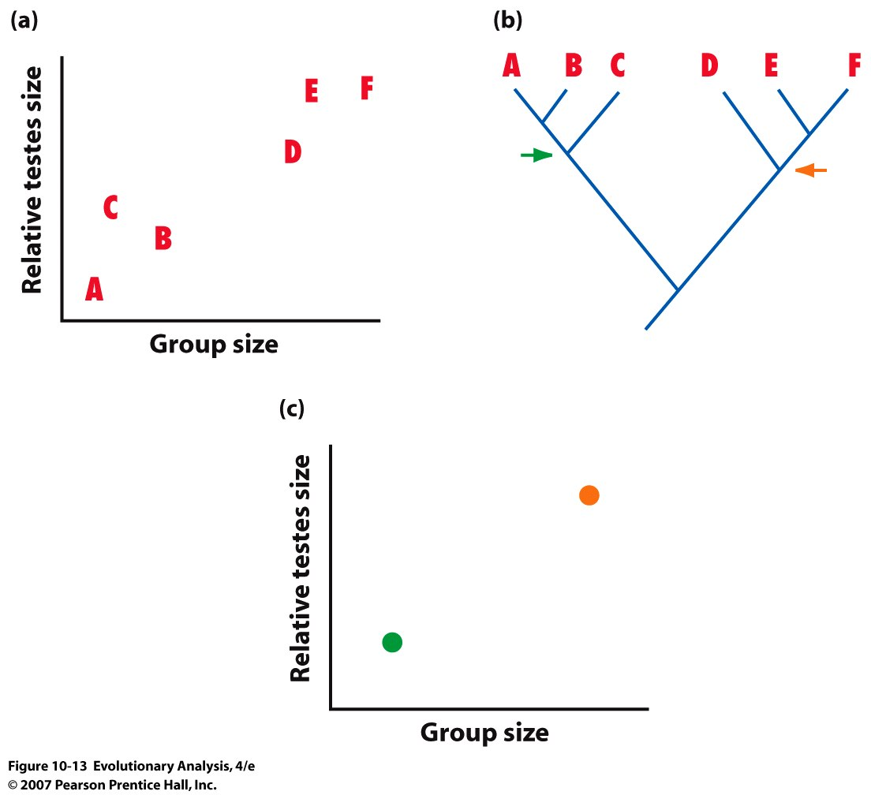
Notes:
Figure 10.13 A simple scatterplot may provide only weak evidence that two traits evolve in tandem
After Lauder et al. (1995).

Slide 19
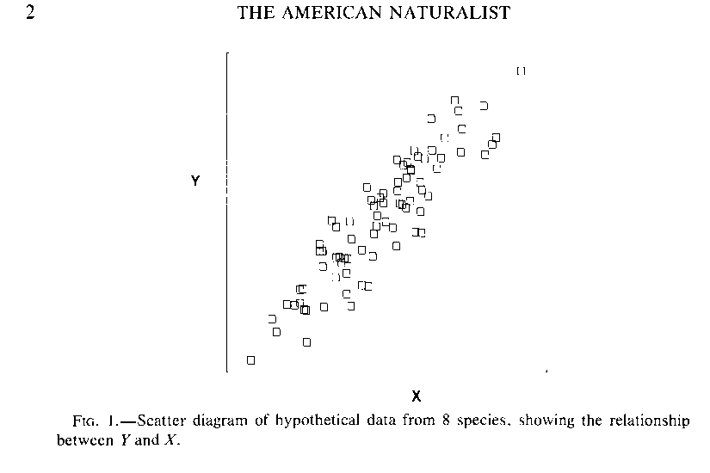
Phylogenetic Comparisons
(Am. Nat, 1985, 125: 1-15,
Adapted from J. Felsenstein)
Scatter diagram of hypothetical data from 40 species, showing the relationship between Y and X
1 2 … 39 40
Treating each species independently reflects a phylogeny
where each species and traits, x and y evolved independently

Slide 20
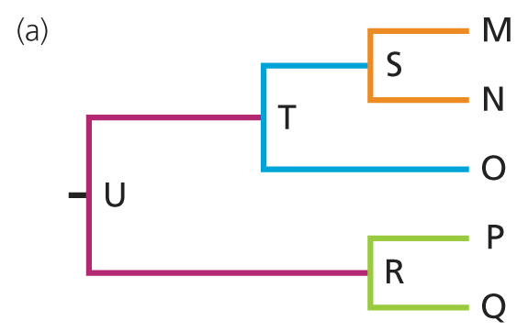
Felsenstein Revisited

Slide 21
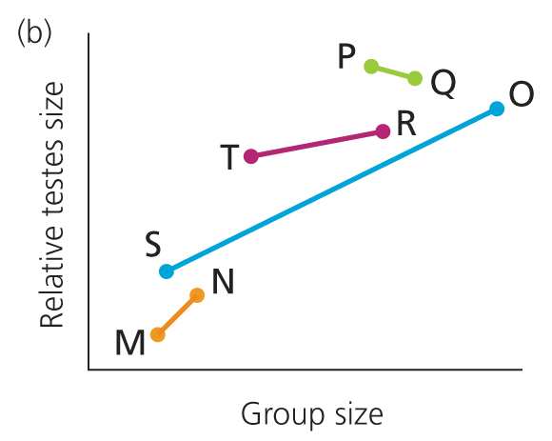

Slide 22
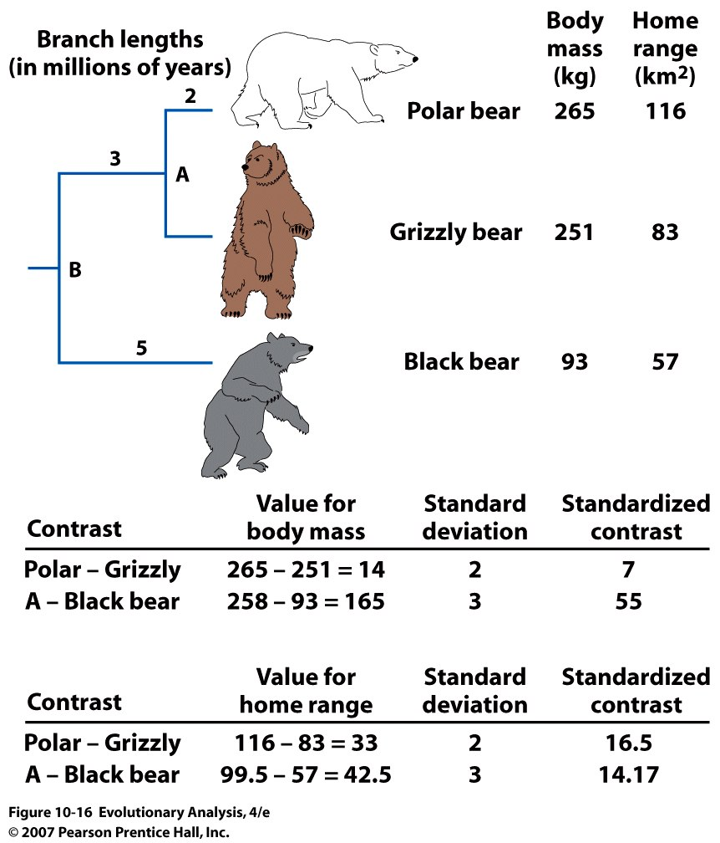
Notes:
Brownian motion:
Figure 10.16 An example showing how the data are adjusted when calculating phylogenetically independent contrasts
From Garland and Adolph (1994).
Standard deviation:
Polar bear vs Grizzly, sq rt (2 + 2)
A vs black bear:
3 + (2x2)/(2+2) = 4
Sqrt (4 + 5) = 3

Slide 23
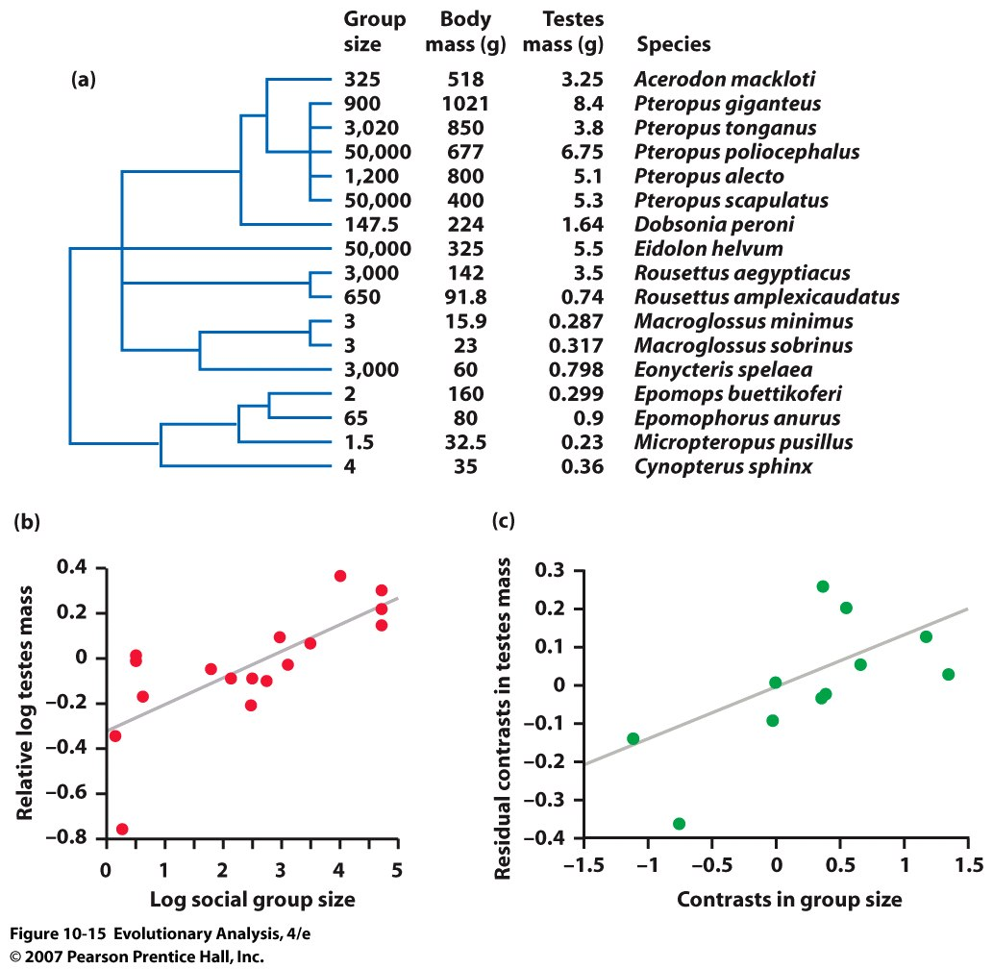
Returning to Bats and Testis Size:
N = 17 N = 11
Notes:
Draw on Board and work through
Figure 10.15 Correlated evolution of group size and testes size in fruit bats and flying foxes
A phylogeny for 17 species of bats, showing roost group size, body mass, and testes mass for each species. (b) The correlation between relative testes size and roost group size among the 17 species shown in the phylogeny, uncorrected for the influence of phylogenetic history. (c) Independent contrasts for relative testes size versus group size. The points on this graph show that when a bat species evolved larger (or smaller) group sizes than its sister species, it also tended to evolve larger (or smaller) testes (P = 0.027). From Hosken (1998).
1 vs 2-6
1-6 vs 7
1-7 vs 9-13
9 vs 10
11 vs 12
14 vs 15
9 and 10 vs 11=13
11 and 12 vs 13
14 and 15 vs 16
14-16 vs 17
8 vs 14-17

Slide 24
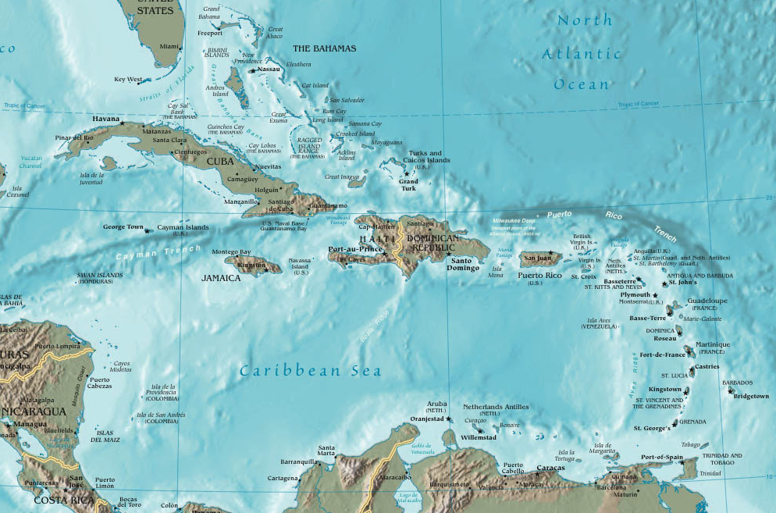
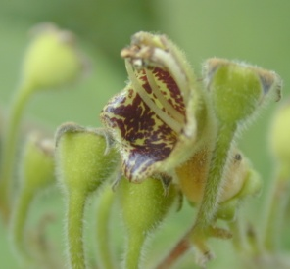
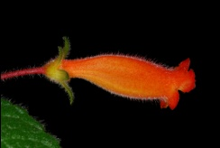
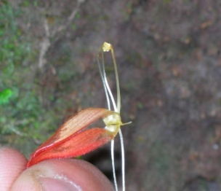
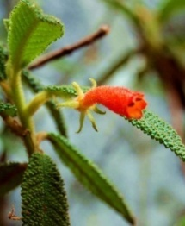
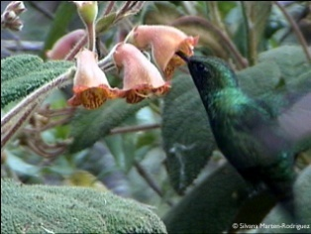
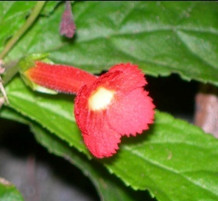
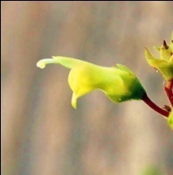
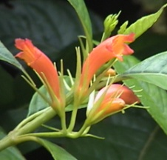
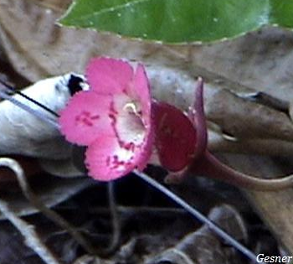
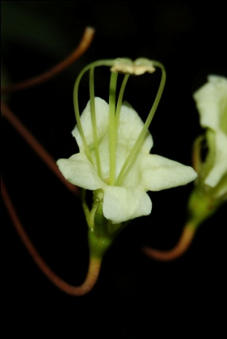
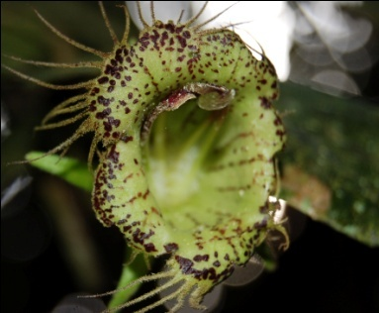
Pollination and breeding system evolution in Caribbean Gesnerieae

Slide 25
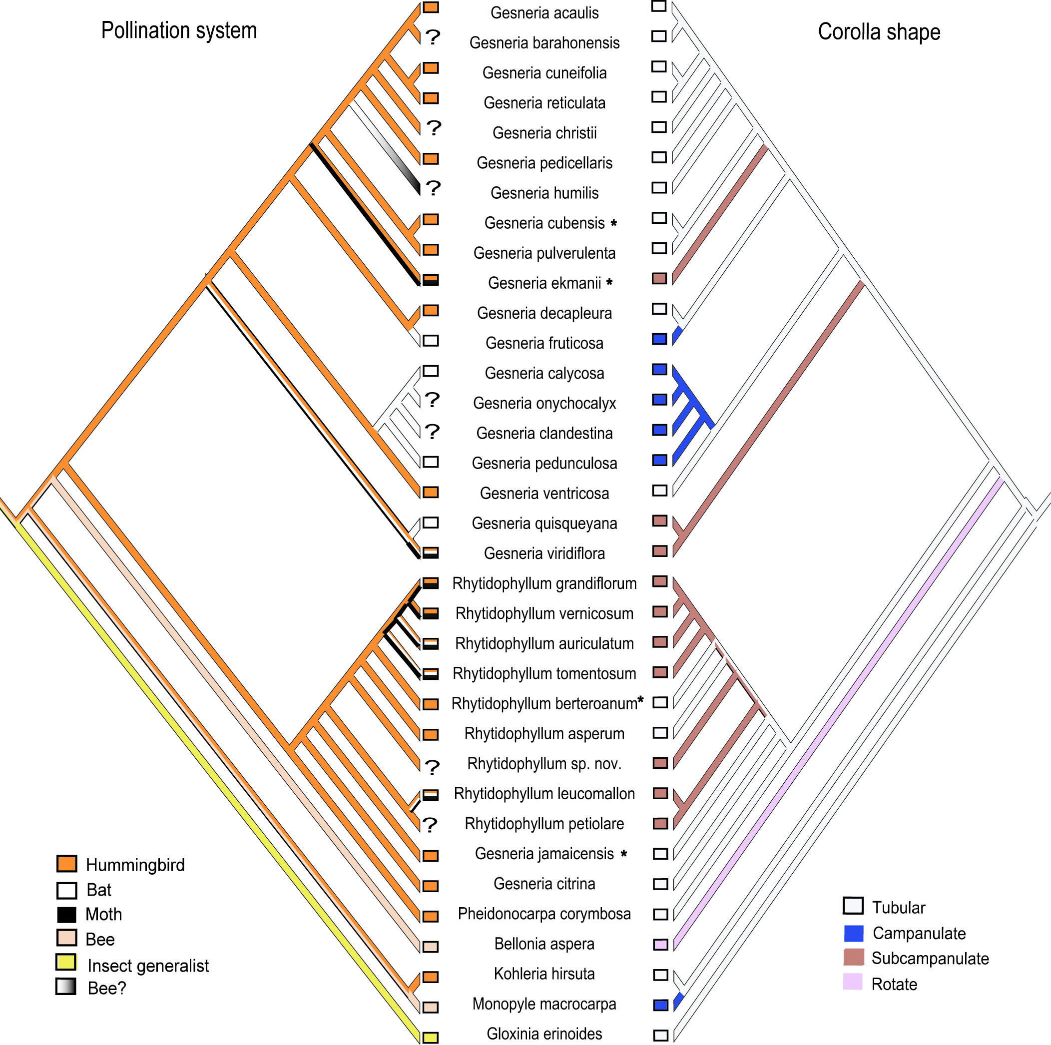
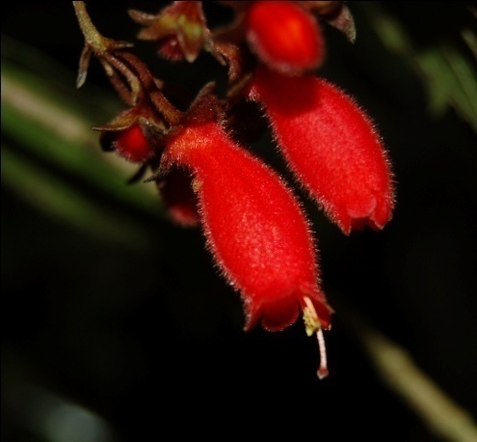
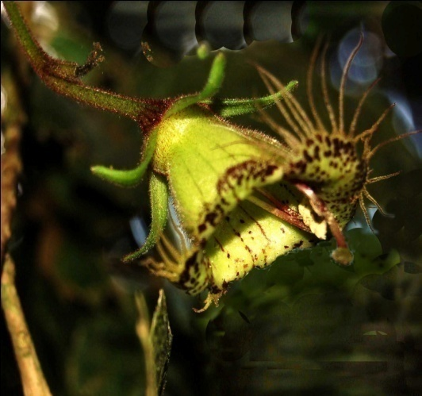
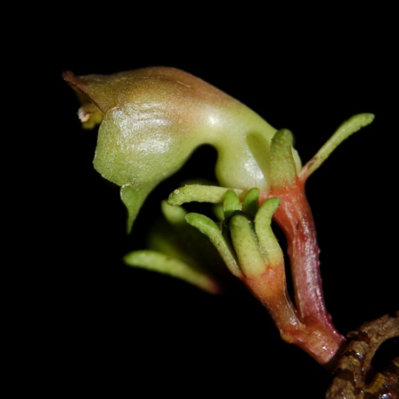
G. decapleura Hispaniola
G. fruticosa Hispaniola
G. viridiflora
Puerto Rico
Marten-Rodriguez, 2010, New Phytologist

Slide 26
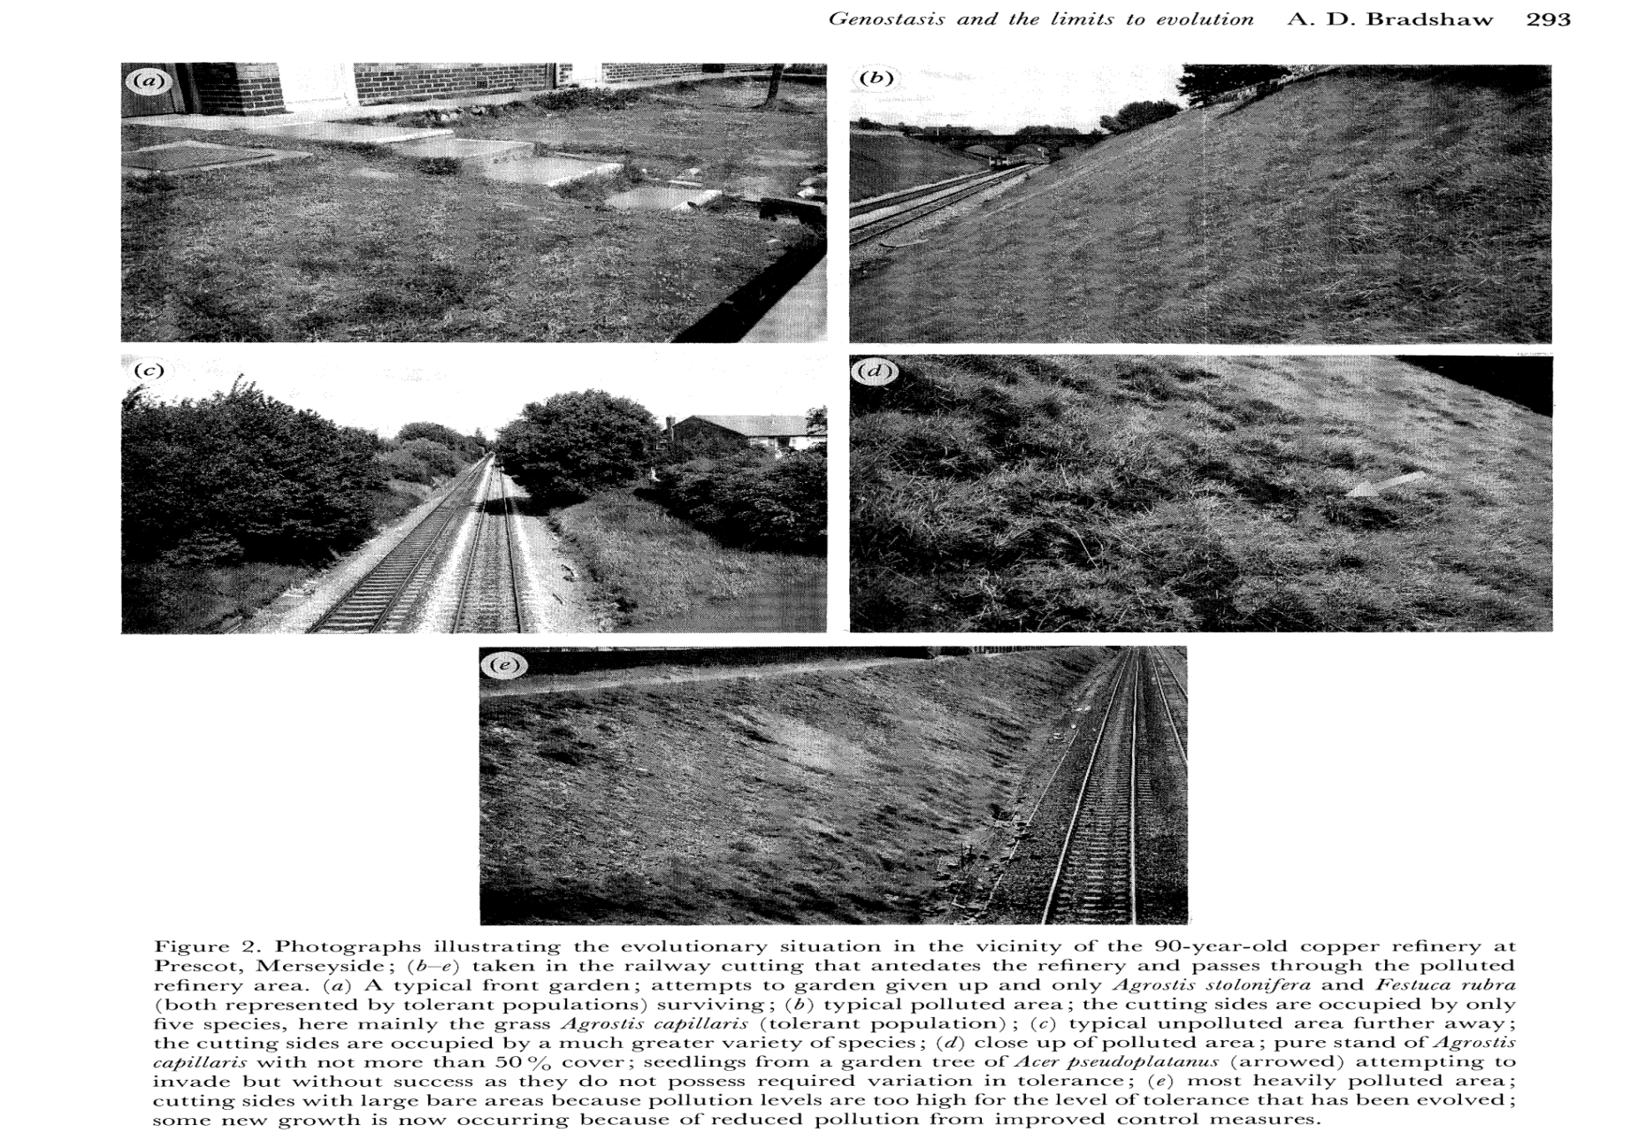
V. Constraints to Adaptation- lack of genetic variation
Evolution of Heavy Metal Tolerance by Grasses

Slide 27
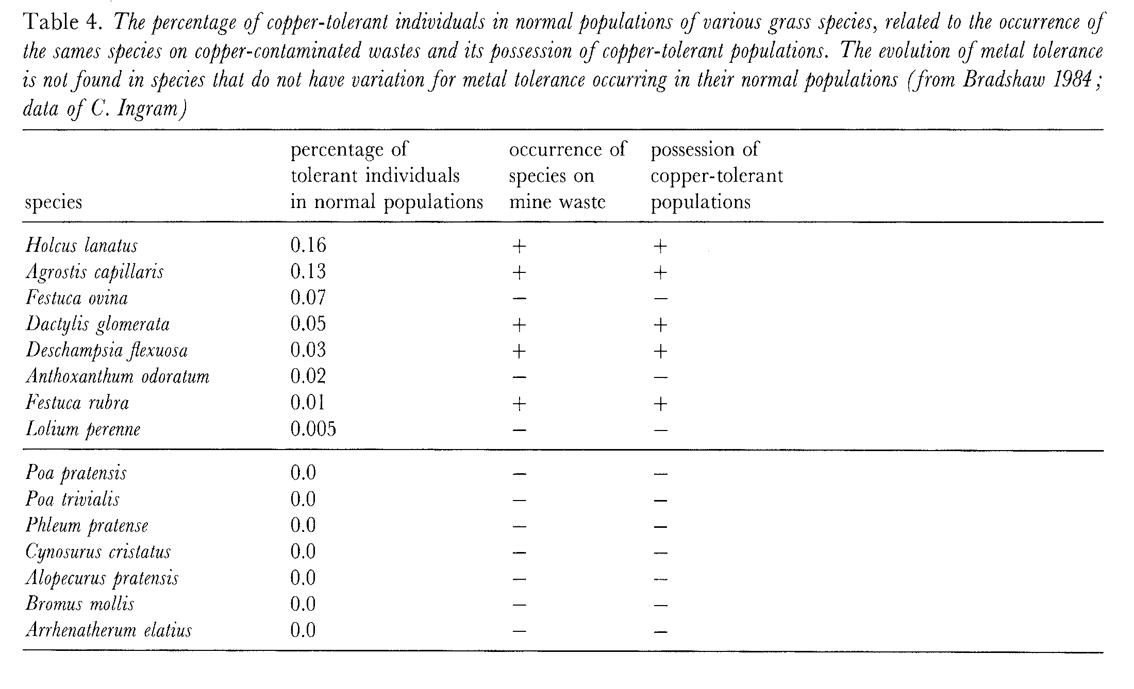
Lack of genetic variation explains lack of adaptation of
heavy metal tolerance, from Bradshaw, Proc. Roy. Soc.
Biol. Ser. B. 1991
Notes:
An organism needs to have genetic variation to evolve to a new environment or selective agent.

Slide 28
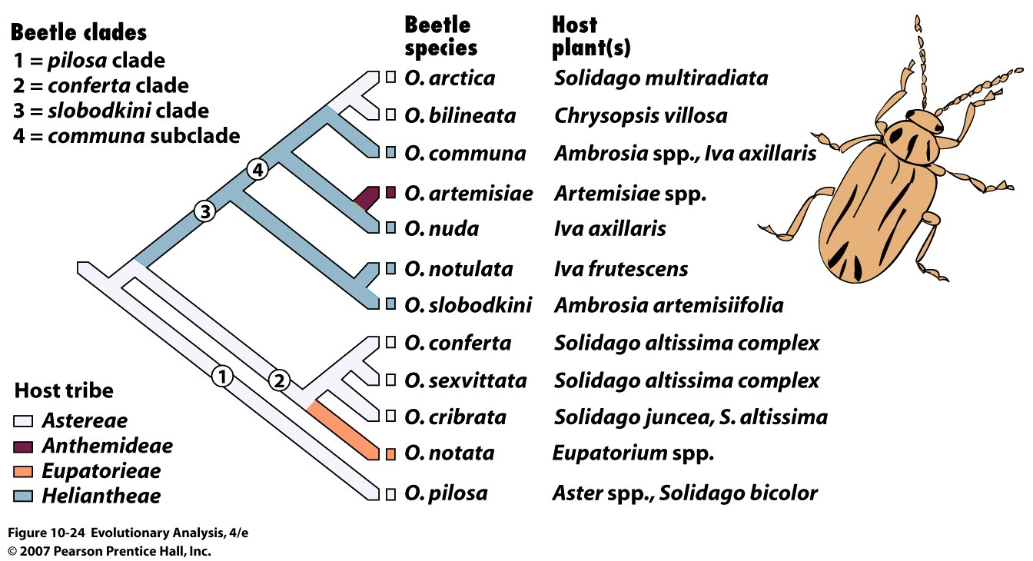
Host Shifts in an Herbivorous Beetle
Notes:
Figure 10.24 Phylogeny of the leaf beetles, genus Ophraella
The numbers on the tree define the major branches (clades) of beetles. The shading of branches indicates the tribes of host species. The evolutionary history of the beetle genus has included four host shifts across tribes. From Futuyma et al. (1995).

Slide 29
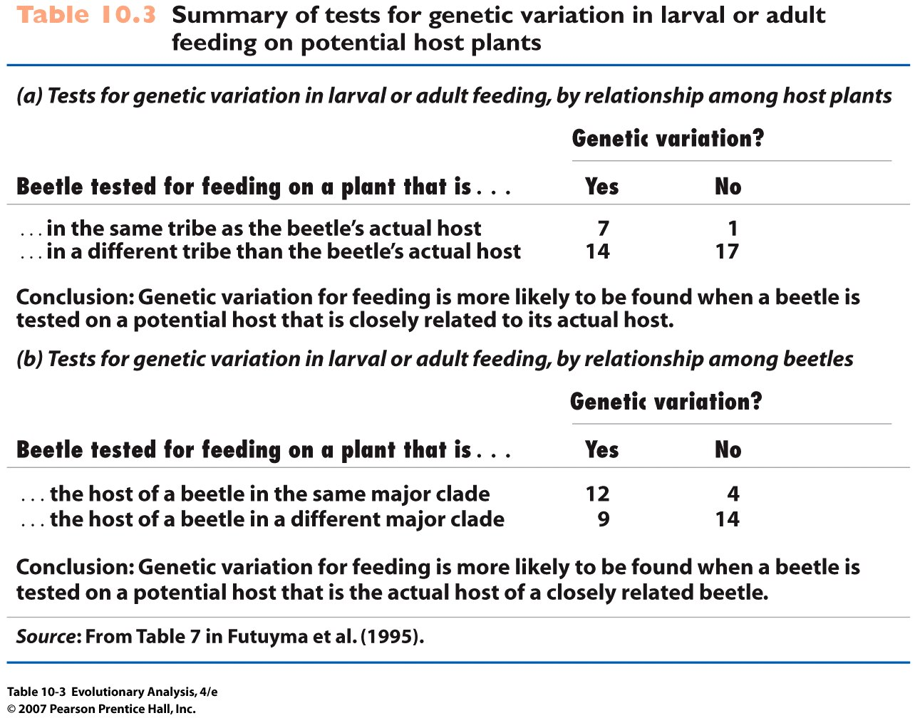
Notes:
Table 10.3 Summary of tests for genetic variation in larval or adult feeding on potential host plants

Slide 30
VI. Conclusions
How to test for an adaptation
Experimental manipulation of trait within species
Short-term evolutionary “experiments”
Tests of associations
Phylogenetic analysis of trait association with an environment (group size, etc.)
Type and amount of genetic variation

